Slide 1

Welcome To Our Project Presentation.

Slide 2
Team Members
Prima Rani Chanda 172-15-9713
Md. Abdullahil-Oapy 172-15-9868
Md. Rafiuzzaman Bhuiyan 172-15-9655
Sharon Kumar Das 172-15-9991

Slide 3
Restaurant Management System.

Slide 4
Contents:
• Introduction to the project
• Project Goal
• Software Process Model
• Software Tools & Technologies
• Use case Diagram.
• Screenshot.
• Data flow Diagram
• Project Scope
• Advantages

Slide 5
Introduction:
Online Restaurant Management System is the process of ordering food from a website .The product can be either ready-to-eat food. The aim of developing Online Restaurant Management project is to replace the traditional way of taking orders with computerized system. Another important reason for developing this project is to prepare order summary reports quickly and in correct format at any point of time when required.

Slide 6
Project Goal :
Our main goal of this project to create such a restaurant management software or system which will save time of both customers and restaurant management team . On the other hand it will help ta run business with much more efficiently than past.

Slide 7
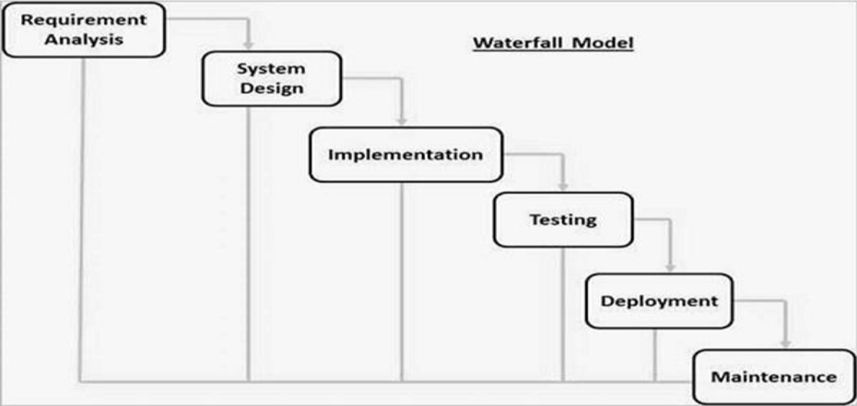
Software Process Model:

Slide 8
Software Tools:
Development Tools: Vs Code editor, Brackets, Sublime text.
Database: MySQL.
Client: Web browser.
Programming Language: HTML, CSS, Js , PHP, SQL.

Slide 9
Hardware Specification:
Processor: Intel Core i3
RAM: 2GB(Minimum)
Hard Disk: 256GB(Minimum)

Slide 10
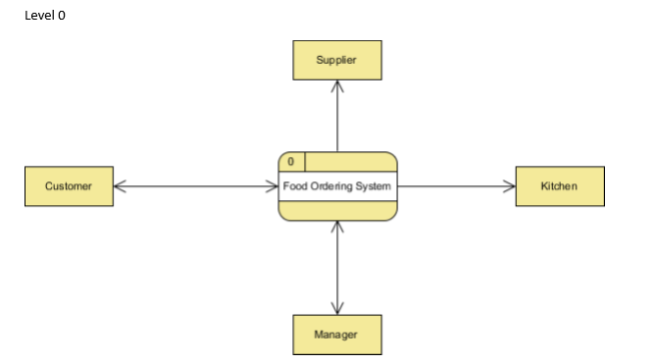
Figure: Data flow of Online Restaurant Management

Slide 11
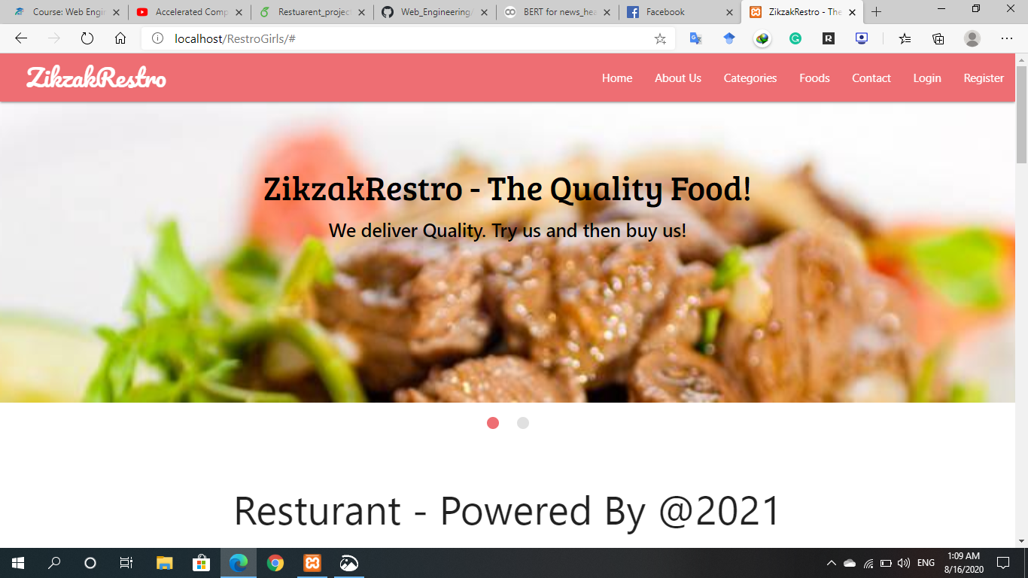
Home Page:

Slide 12
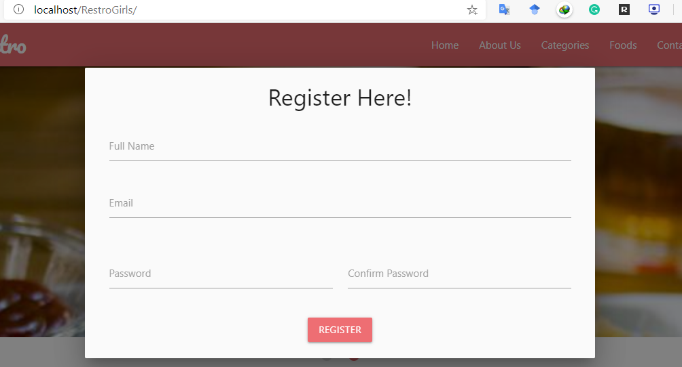
Registration Page:

Slide 13
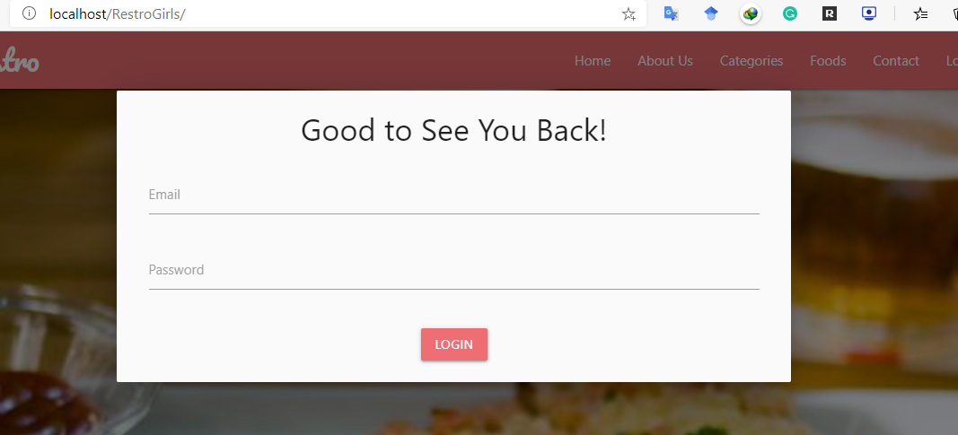
Log in Page:

Slide 14
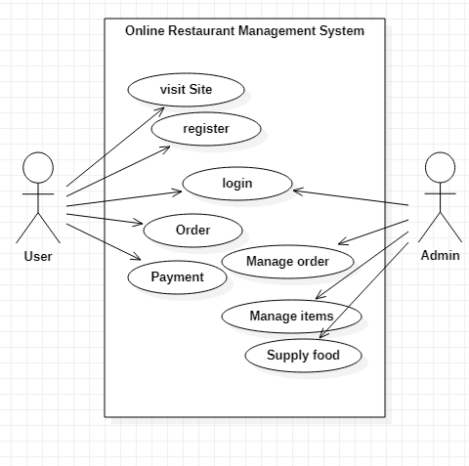
Figure: Use case Diagram of Online Restaurant Management System

Slide 15
Project Scope:
Online Restaurant Management has a very lot of scope. This PHP project can be used by any restaurants or fast foods for customers for keeping their order records. This project is easy, fast and accurate. It requires less disk space.

Slide 16
Advantages:
*Easy to use.
*Anyone can see all information.
*Management all process easier.
*Meals can be ordered easily.
*Buyers can easily order the food of their choice at any time.
*Time will not be wasted.

Slide 17
Thank You…

